Slide 1
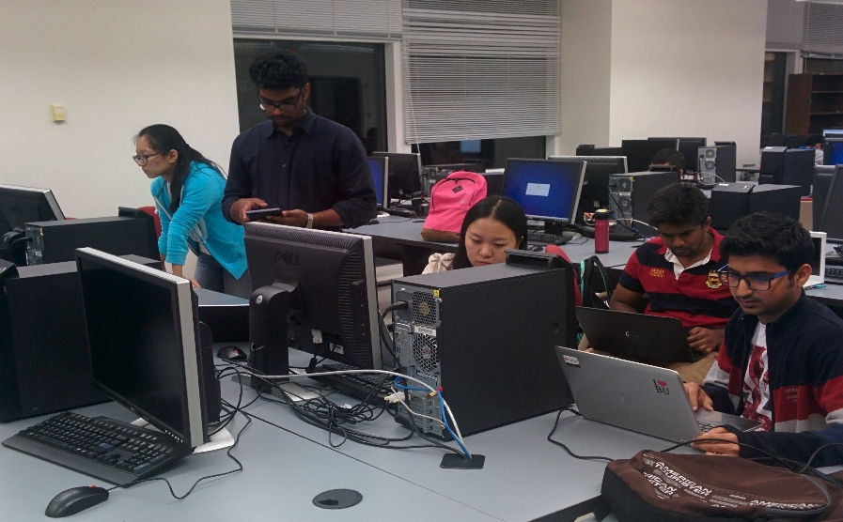
Sprint 3 Jitsi Android Application
By :-
Karunesh Mahajan
Ganesh Seshank
Hitesh Laware
Lina Hou
Chuang Ding
Project Advisor
Professor Osama Alshaykh

Slide 2

Sprint 3 tentative targets decided after Sprint 2
Design an invite mechanism through the Android client.
Modify existing Jitsi Video Bridge features.
Add new features.
Delete unwanted features.
Integrate it with our App.
Improve Video quality.
Test the App on different platforms with various test cases.
Auto registering the users logging in first time from google/facebook.
Fix all the bugs and make the app stable.

Slide 3
Contact List

Slide 4
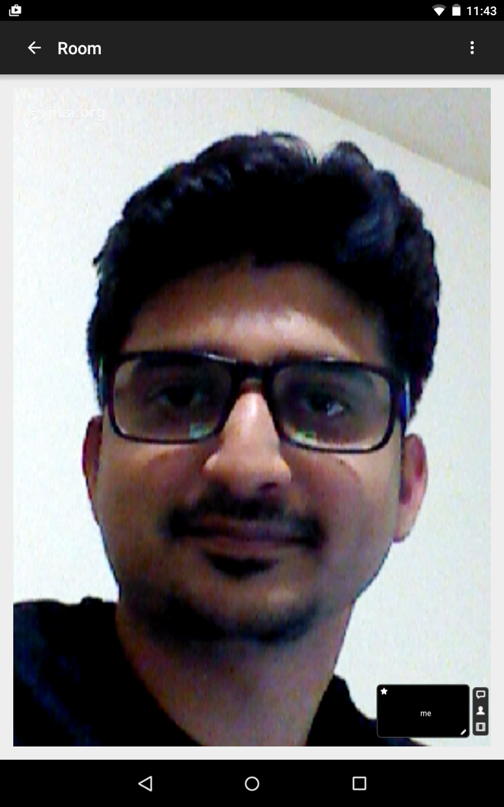
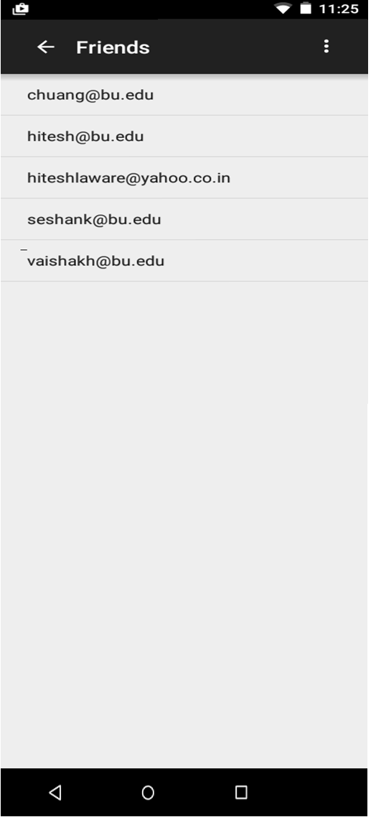
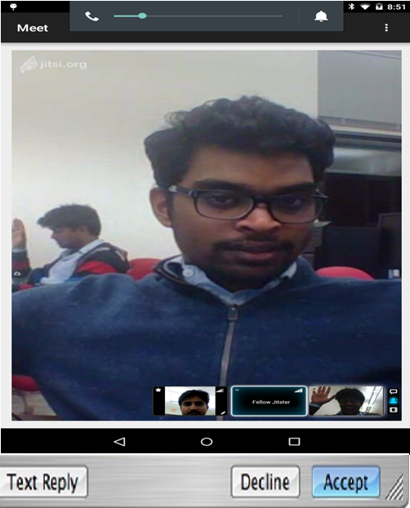
Invitation flow sequence
Open Jitsi Meet
See Contact list
Invite Contact to Join Video Chat by sending an Email.
Accept Invitation to join chat using the link in the Email.
INVITE

Slide 5
Sprint 4 targets
Efficient application of the process of Invitation.
Add/Remove original features in Jitsi.
Carryout further testing and bug fixing.
Bring stability to the app.
Stability in terms of audio & video quality.
Add security features.
Give authority to admin to accept or deny add permission.
Make the app more user friendly.

Slide 7
Thank you !
Q&A

